Slide 1
Introduction
Our project was developing a Treasure Hunt game by learning Python. But 2 weeks into the project, we realized that for visual applications like games, better software substitutes are available.
Thus our search began and landed on Phaser. Phaser is a free software 2D game framework for making HTML5 games. It is easy to learn and make games.

Slide 2
Software used
Javascript
Phaser 3 framework
HTML5
Web server for Chrome (extension)
to host web pages from a local folder using HTTP

Slide 3
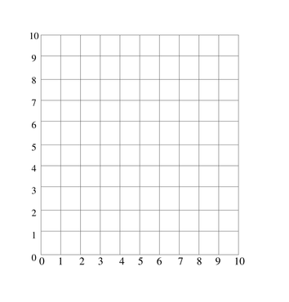




Setting up

Slide 4
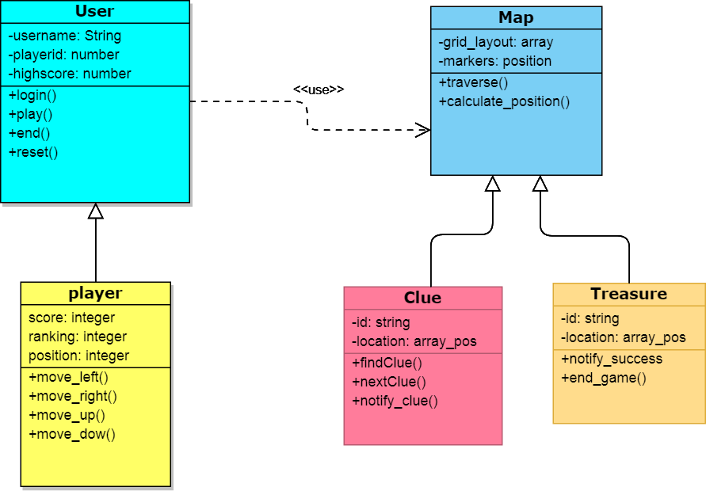
UML Class Diagram

Slide 5
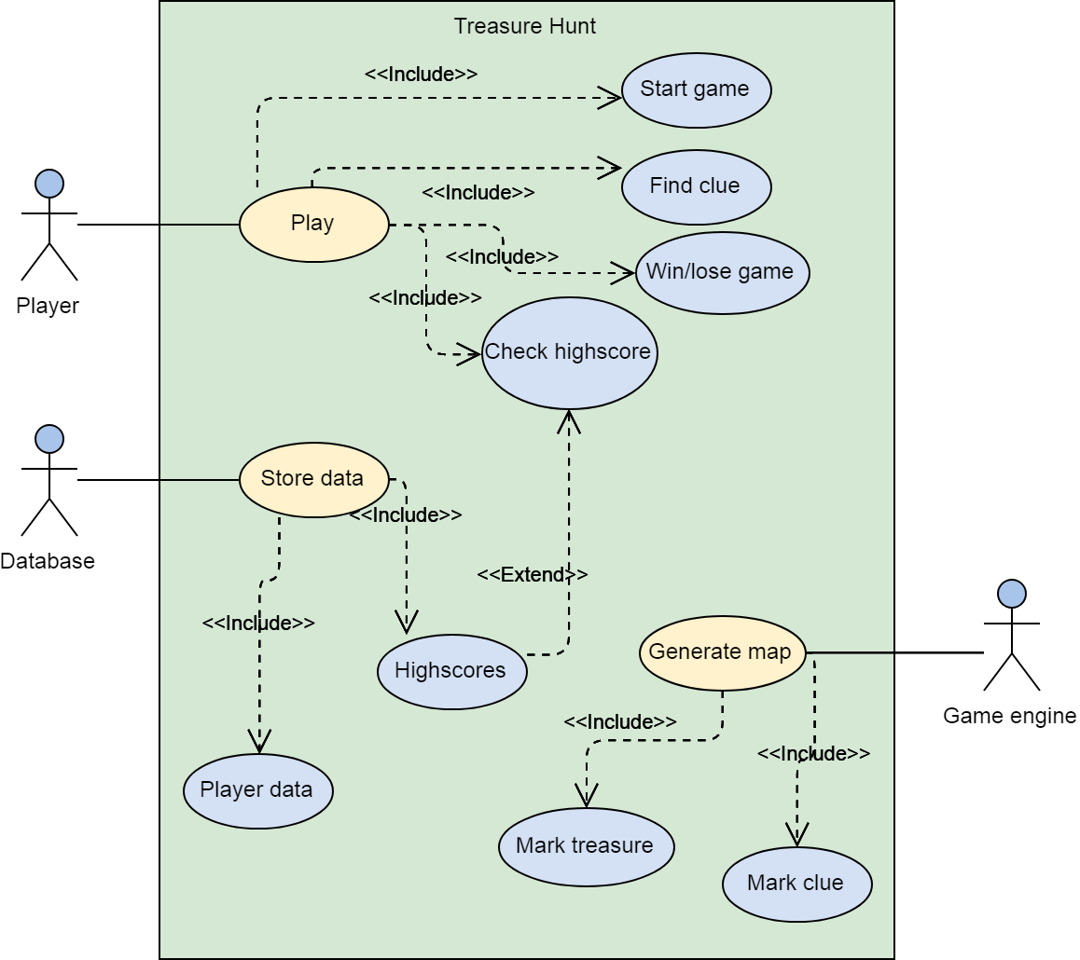
UML usecase diagram

Slide 6

Ask us questions.

